Slide 1
The Big Picture- Intent:
Y7 Computing is an exciting subject for many students. Students are introduced to the school network, with a brief overview of how it functions and what safeguarding principles are built into it. The introduction to the network enables students to access resources on a cross curricular basis and introduces students to the various systems that will be routinely used by students. Students will study data representations, allowing them to understand how computers use binary to represent text, images and sound. Students will gain an understanding of networking, and explore how networking protocols have enabled the creation of wide area networks. Students will build upon knowledge of algorithms delivered in KS2 and will be introduced to a text based programming language – Python. This unit is the basis for two further units delivered in years 8 and 9 and teaches students to apply decomposition and sequencing skills to problem solving.
All students will be able to access the main content of all lessons and all students will be taught to the top with scaffolding, adaptive teaching and stretch and challenge provided where necessary.
Implementation: There are four units delivered in year 7. Each lesson will begin with a retrieval practice activity in the form of Revise, Recap, Review. This will normally involve students answering 3 questions from last lesson, followed by 2 questions from previous study and one more challenging question. Each activity will involve students being posed questions interleaved over multiple units delivered throughout the year. Students are encouraged work independently through the provision of scaffolding where required. Computing lessons often involve the application or practical/technical skills. These will be modelled to students using the I do, we do, you do approach. Students will be assessed at the end of each unit. Following assessment, students will complete a follow up activity based upon the individual area of weakness identified.
Collaborating online respectfully: A primer for learners on how to use the school network appropriately. This unit builds in time for teacher-led discussions on why appropriate usage is important, as well as allowing for opportunities to highlight online safety issues.
Data Representation: Learners are introduced to binary and how this number system is represented inside of a computer system using transistors. Students will learn how to convert from binary to decimal and vice versa as well as how binary can be used to represent text, images and sound
Networks: Students will learn what a network is and the relative merits and drawbacks of networking computers. Students will then understand how networking different devices, made in different countries by different manufacturers is possible because of the use of protocols
An introduction to python: Building upon knowledge of block based programming in KS2, students will learn how the skills an concepts from KS2 can be applied to a text based programming language.
End of year project: Students will combine all of the skills taught in the units this year into an end of year project on a common theme
Key Summative Assessments:
End of unit assessments after each unit
Retrieval homework. ​
​
Live marking and low stakes quizzing ​
End of year project
Autumn Term:
Collaborating online respectfully
Spring term:
Networks
Data representation
Summer Term:
Programming in Python
End of year project
YEAR 7 CURRIULUM OVERVIEW – SUBJECT NAME
Impact: Students will know how to ensure they are safe when using online services. Importantly, students will know what to do if they do have an online concern and how to report this effectively. Students will gain an understanding of how computers are able to represent data using just 1’s and 0’s. Students will gain an understanding and appreciation as to how many of the services they interact with each day actually work, and how data can travel vast distances in doing so. Students will learn to think – They will increase their problem solving and analytical skills through learning to program in a text based language.
Students will know more, and remember more through the delivery of regular retrieval practice

Slide 2
Content​ | Disciplinary Knowledge (Skills)​ This is the actions taken within a ​ topic to gain ​ substantive knowledge​ | Substantive Knowledge​ This is the specific, factual content ​ for the topic, which is connected into a careful sequence of learning. ​ | Prior Learning (Y6)​ | Future learning (Y8)​
Collaborating online respectfully | Selecting a suitable password based upon best practice Sending, responding and forwarding emails Appropriate Use of CC and BCC Effective use of constructive criticism in improving student work Creation of online collaborative documents Audience considerations when designing presentations Delivery of presentations to the group | Authentication Safety in computing labs Respectful communication Emails E-safety and cyber bullying Presenting to an audience Reporting concerns Privacy settings | select, use and combine a variety of software (including internet services) on a range of digital devices to design and create a range of programs, systems and content that accomplish given goals, including collecting, analysing, evaluating and presenting data and information use technology safely, respectfully and responsibly; recognise acceptable/unacceptable behaviour; identify a range of ways to report concerns about content and contact. | Vector graphics
Data representations | Students know why binary numbers are integral to computing Binary to decimal conversion Students can identify logic gates and produce truth tables Explain how images, text and sound can be represented in binary | Binary Binary/decimal conversions Logic gates and logic circuits Text, image and sound representation

Slide 3
Content​ | Disciplinary Knowledge (Skills)​ This is the actions taken within a ​ topic to gain ​ substantive knowledge​ | Substantive Knowledge​ This is the specific, factual content ​ for the topic, which is connected into a careful sequence of learning. ​ | Prior Learning (Y6)​ | Future learning (Y8)​
Networks | To be able to articulate what is meant by the term network and provide examples Explore how protocols enable the compatibility of different devices Approximate bandwidth requirements for a given task Show contents of packets and how multiple packets can be used to send information Demonstrate an understanding of the role of a router in the creation of the internet | Network definition Protocols Network hardware Wired, wireless and cellular networks Bandwidth The internet as a WAN Packet switching Internet services/internet of things The world wide web Browsers, search engines and domains | understand computer networks including the internet; how they can provide multiple services, such as the world wide web; and the opportunities they offer for communication and collaboration | Representations
An introduction to programming | Apply computational thinking techniques to a series of problems Be able to output messages to the console Create a program in a block based language and duplicate it in a text based language Understand the concept of a variables and utilise them to store values Use simple arithmetic operators in a program Use error messages to debug programs Use the turtle module to add graphics to text based programs | Abstraction Decomposition Algorithmic thinking Inputs and outputs Variables Arithmetic Errors and debugging Selection | design, write and debug programs that accomplish specific goals, including controlling or simulating physical systems; solve problems by decomposing them into smaller parts | More python

Slide 4
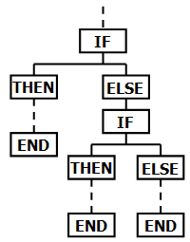
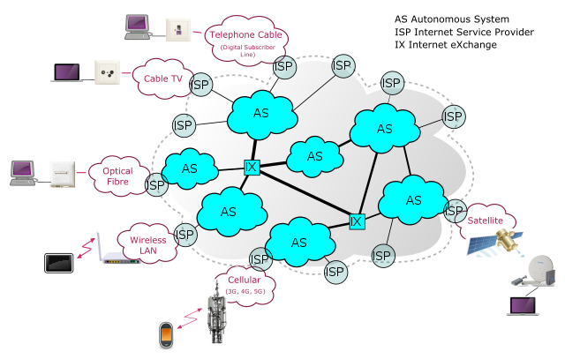
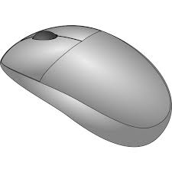
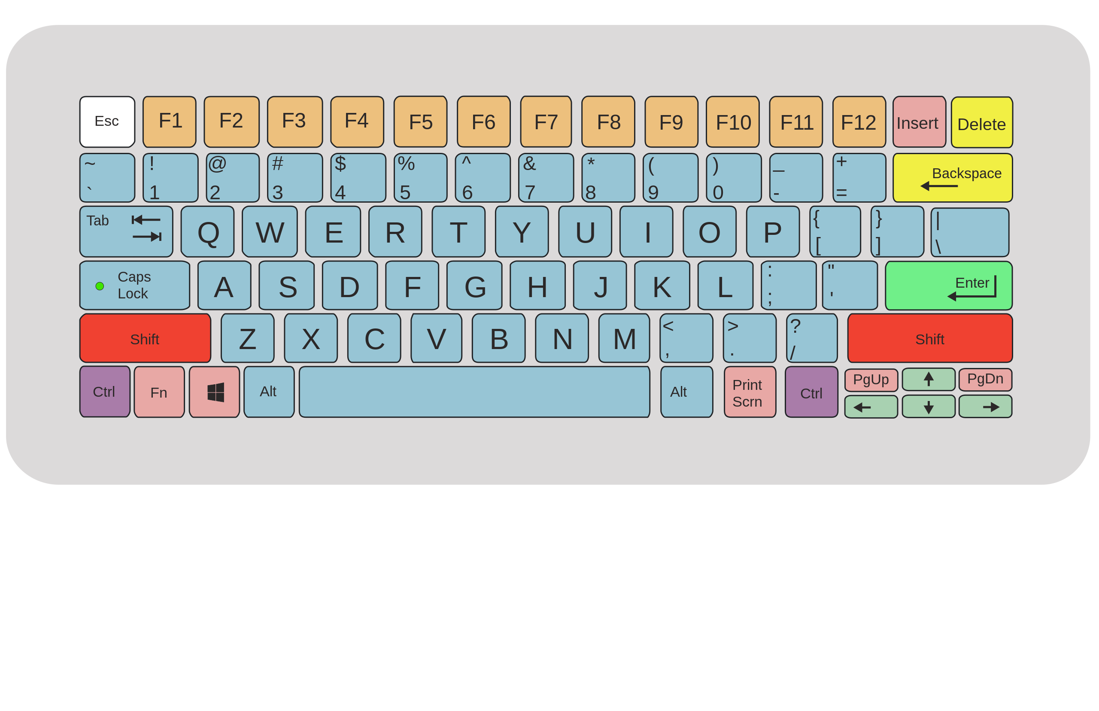
Year 7 Computing Learning Journey
End of year 7 …..
Year 8
End of year project
Block based coding
Text based coding in python
Variables
Inputs
Outputs
Selection
Programming in Python
Binary number system
Binary conversions
Representing characters
Representing images
Representing sounds
Data Representation
What is a network?
Hardware
Protocols
Wired and wireless networks
The internet
Networks
Basic operations
Collaborating respectfully
E-safety
Introduction to the network
Start
Notes:
2022 - 23

Slide 5
The Big Picture- Intent:
During year 8, students will discover what hardware and software are and discover how hardware functions within the computer system. This will enable them to gain an understanding of the common components found within all types of computers. Building upon content taught in year 7, students will apply their understanding of WWW technologies in designing and creating webpages using HTML and CSS. This will give students a deeper understanding of how the services they utilise on a daily basis are created. Building upon knowledge gained in year 7, students will further develop skills in python programming. The basics will be revisited before delving into more complex problems and introducing more advanced techniques. Students will explore the use of vector graphics and how these differ from raster images. This will give students the opportunity to use computers in a creative manner to produce projects for an intended audience. Students will learn how data is represented in binary and how to perform operations on binary numbers. This will combine mathematic and logical skills.
All students will be able to access the main content of all lessons and all students will be taught to the top with scaffolding, adaptive teaching and stretch and challenge provided where necessary.
Implementation: There are 5 units delivered in year 8. Each lesson will begin with a retrieval practice activity in the form of Revise, Recap, Review. This will normally involve students answering 3 questions from last lesson, followed by 2 questions from previous study and one more challenging question. Each activity will involve students being posed questions interleaved over multiple units delivered throughout the year. Students are encouraged work independently through the provision of scaffolding where required. Computing lessons often involve the application or practical/technical skills. These will be modelled to students using the I do, we do, you do approach. Students will be assessed at the end of each unit. Following assessment, students will complete a follow up activity based upon the individual area of weakness identified.
Hardware and software: Students will take a look ‘under the hood’ of a computer system and discover the role of common computer components. Students will look at how hardware and software must interact in unity to create a computer system.
Developing for the web: Students will explore the technologies behind the WWW and develop their own websites using HTML and CSS. Students will consider relevant legislation concerned with the development of websites before exploring how search engines are used to find pages on the WWW.
More Python Programming: Building upon basic knowledge introduced in year 7, students will delve deeper into the world of text based programming. Students will solve more complex problems and be introduced to new concepts such as random number generation and Boolean operators
Vector graphics: Students will undertake a creative project by producing vector graphics. Students will explore the difference between vector and raster images
End of year project: Students will combine all of the skills taught in the units this year into an end of year project on a common theme
Key Summative Assessments:
End of unit assessments after each unit
Retrieval homework. ​
​
Live marking and low stakes quizzing ​
End of year project
Autumn Term:
Hardware and software
Developing for the web
Spring term:
more python programming
Summer Term:
Vector graphics
End of year project
YEAR 8 CURRIULUM OVERVIEW – SUBJECT NAME
Impact: Students will know the main components present in all computer systems. This will lead to an understanding of how all computer systems operate and factors that may affect their performance. Students will be able to apply new knowledge in a practical application and use this to create webpages and websites. This will enable students to have an understanding of how webpages are rendered and how they are able to be viewed on multiple devices. Students will be able to increase their knowledge of programming techniques and apply these to more complex problems. Students will build upon producing more efficient solutions to problems. Students will have the opportunity to use computers in a more creative pursuit by producing vector based graphics. This will give students an understanding of different methods of representing images in computer systems and the relative merits and drawbacks of each approach. Students will discover how different types of data are represented on the computer system and how binary and logic gates form the building blocks of all computer systems.
Students will know more, and remember more through the delivery of regular retrieval practice

Slide 6
Content​ | Disciplinary Knowledge (Skills)​ This is the actions taken within a ​ topic to gain ​ substantive knowledge​ | Substantive Knowledge​ This is the specific, factual content ​ for the topic, which is connected into a careful sequence of learning. ​ | Prior Learning (Y6/7)​ | Future learning (Y9)​
Hardware and Software | Students will explore and be able to articulate the difference between hardware and software Students will suggest suitable input and output devices for a given scenario Explain the purpose of common computer components Have an understanding of why computers were developed and how they differ from modern machines | Hardware and software Inputs and Outputs The parts of a computer Computing history and Moore’s Law
Developing for the web | What aspects make up a good website. What design choices should we avoid when producing content for the needs of all users Gain an understanding of licensing and how this may limit choices when gathering images Use HTML tags with success manipulate the content of a webpage Use CSS to give wider control and design choices to multiple pages of a website Know how search engines index content for easy retrieval | Design considerations Images and copyright HTML Hyperlinks and images CSS Search engines | use search technologies effectively, appreciate how results are selected and ranked, and be discerning in evaluating digital content

Slide 7
Content​ | Disciplinary Knowledge (Skills)​ This is the actions taken within a ​ topic to gain ​ substantive knowledge​ | Substantive Knowledge​ This is the specific, factual content ​ for the topic, which is connected into a careful sequence of learning. ​ | Prior Learning (Y6/7/8)​ | Future learning (Y9)​
More Python Programming | Be able to handle input, output and storage of variables in the console Understand the main data types in python Be able to use casting effectively Understand how Boolean operators can be used to check for multiple conditions Use of IF, ELIF ELSE statements Generate and use random numbers in programs | Inputs and variables Data types strings Boolean operators Selection Random number generation |  | Advanced python programming
Vector Graphics | Manipulate groups of objects Combine paths by applying operations Using multiple tools to produce vector graphics Modify an SVG file to alter a vector image | Creating basic shapes with Inkscape Grouping and paths Icons Producing vector graphics Vector and raster graphics

Slide 8
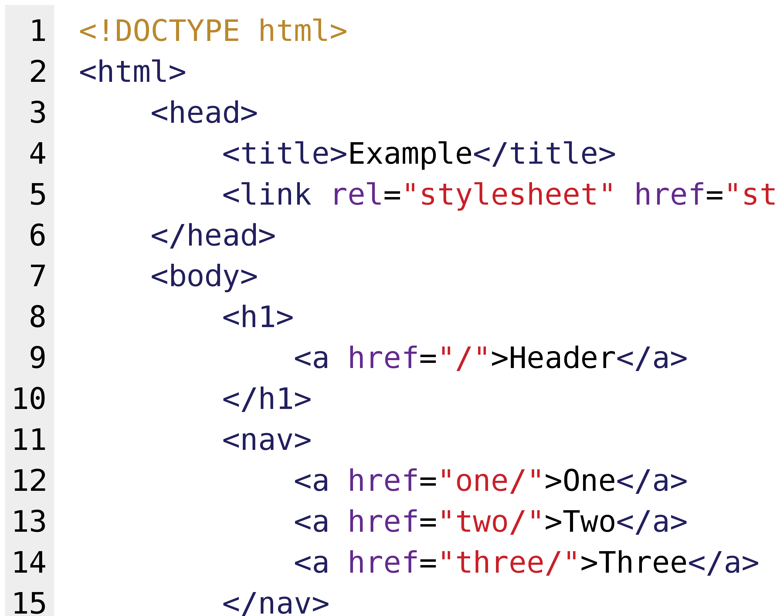
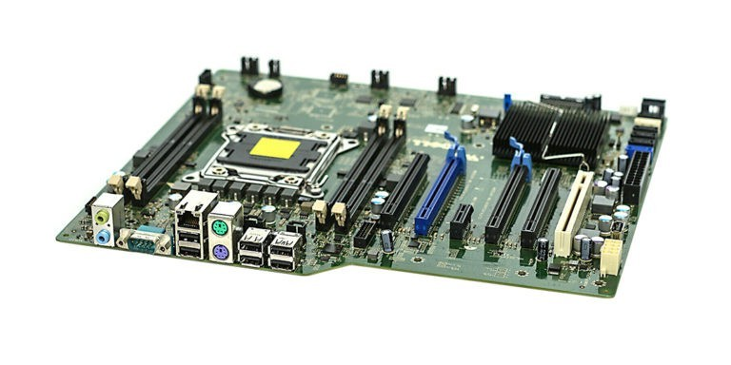
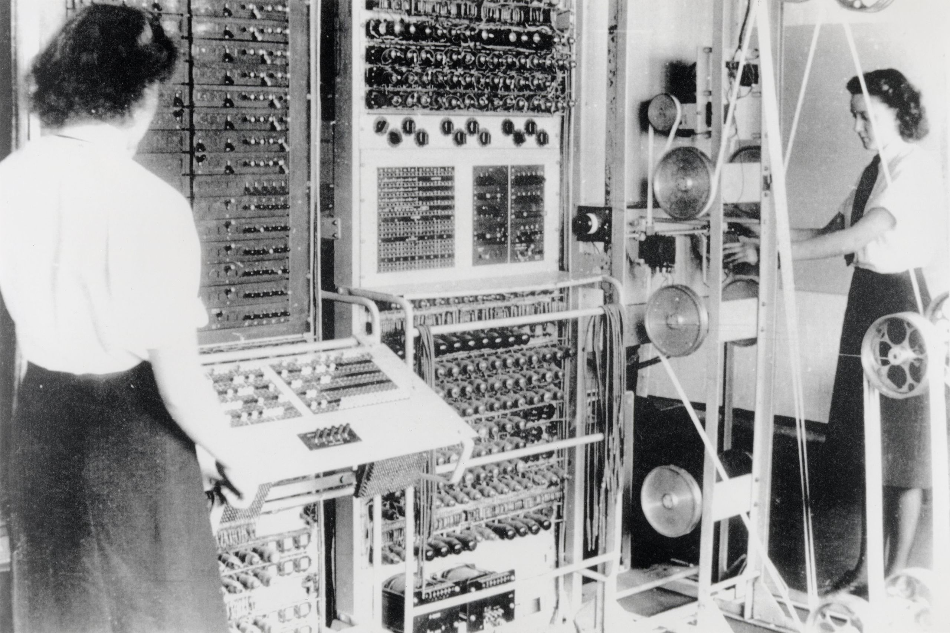
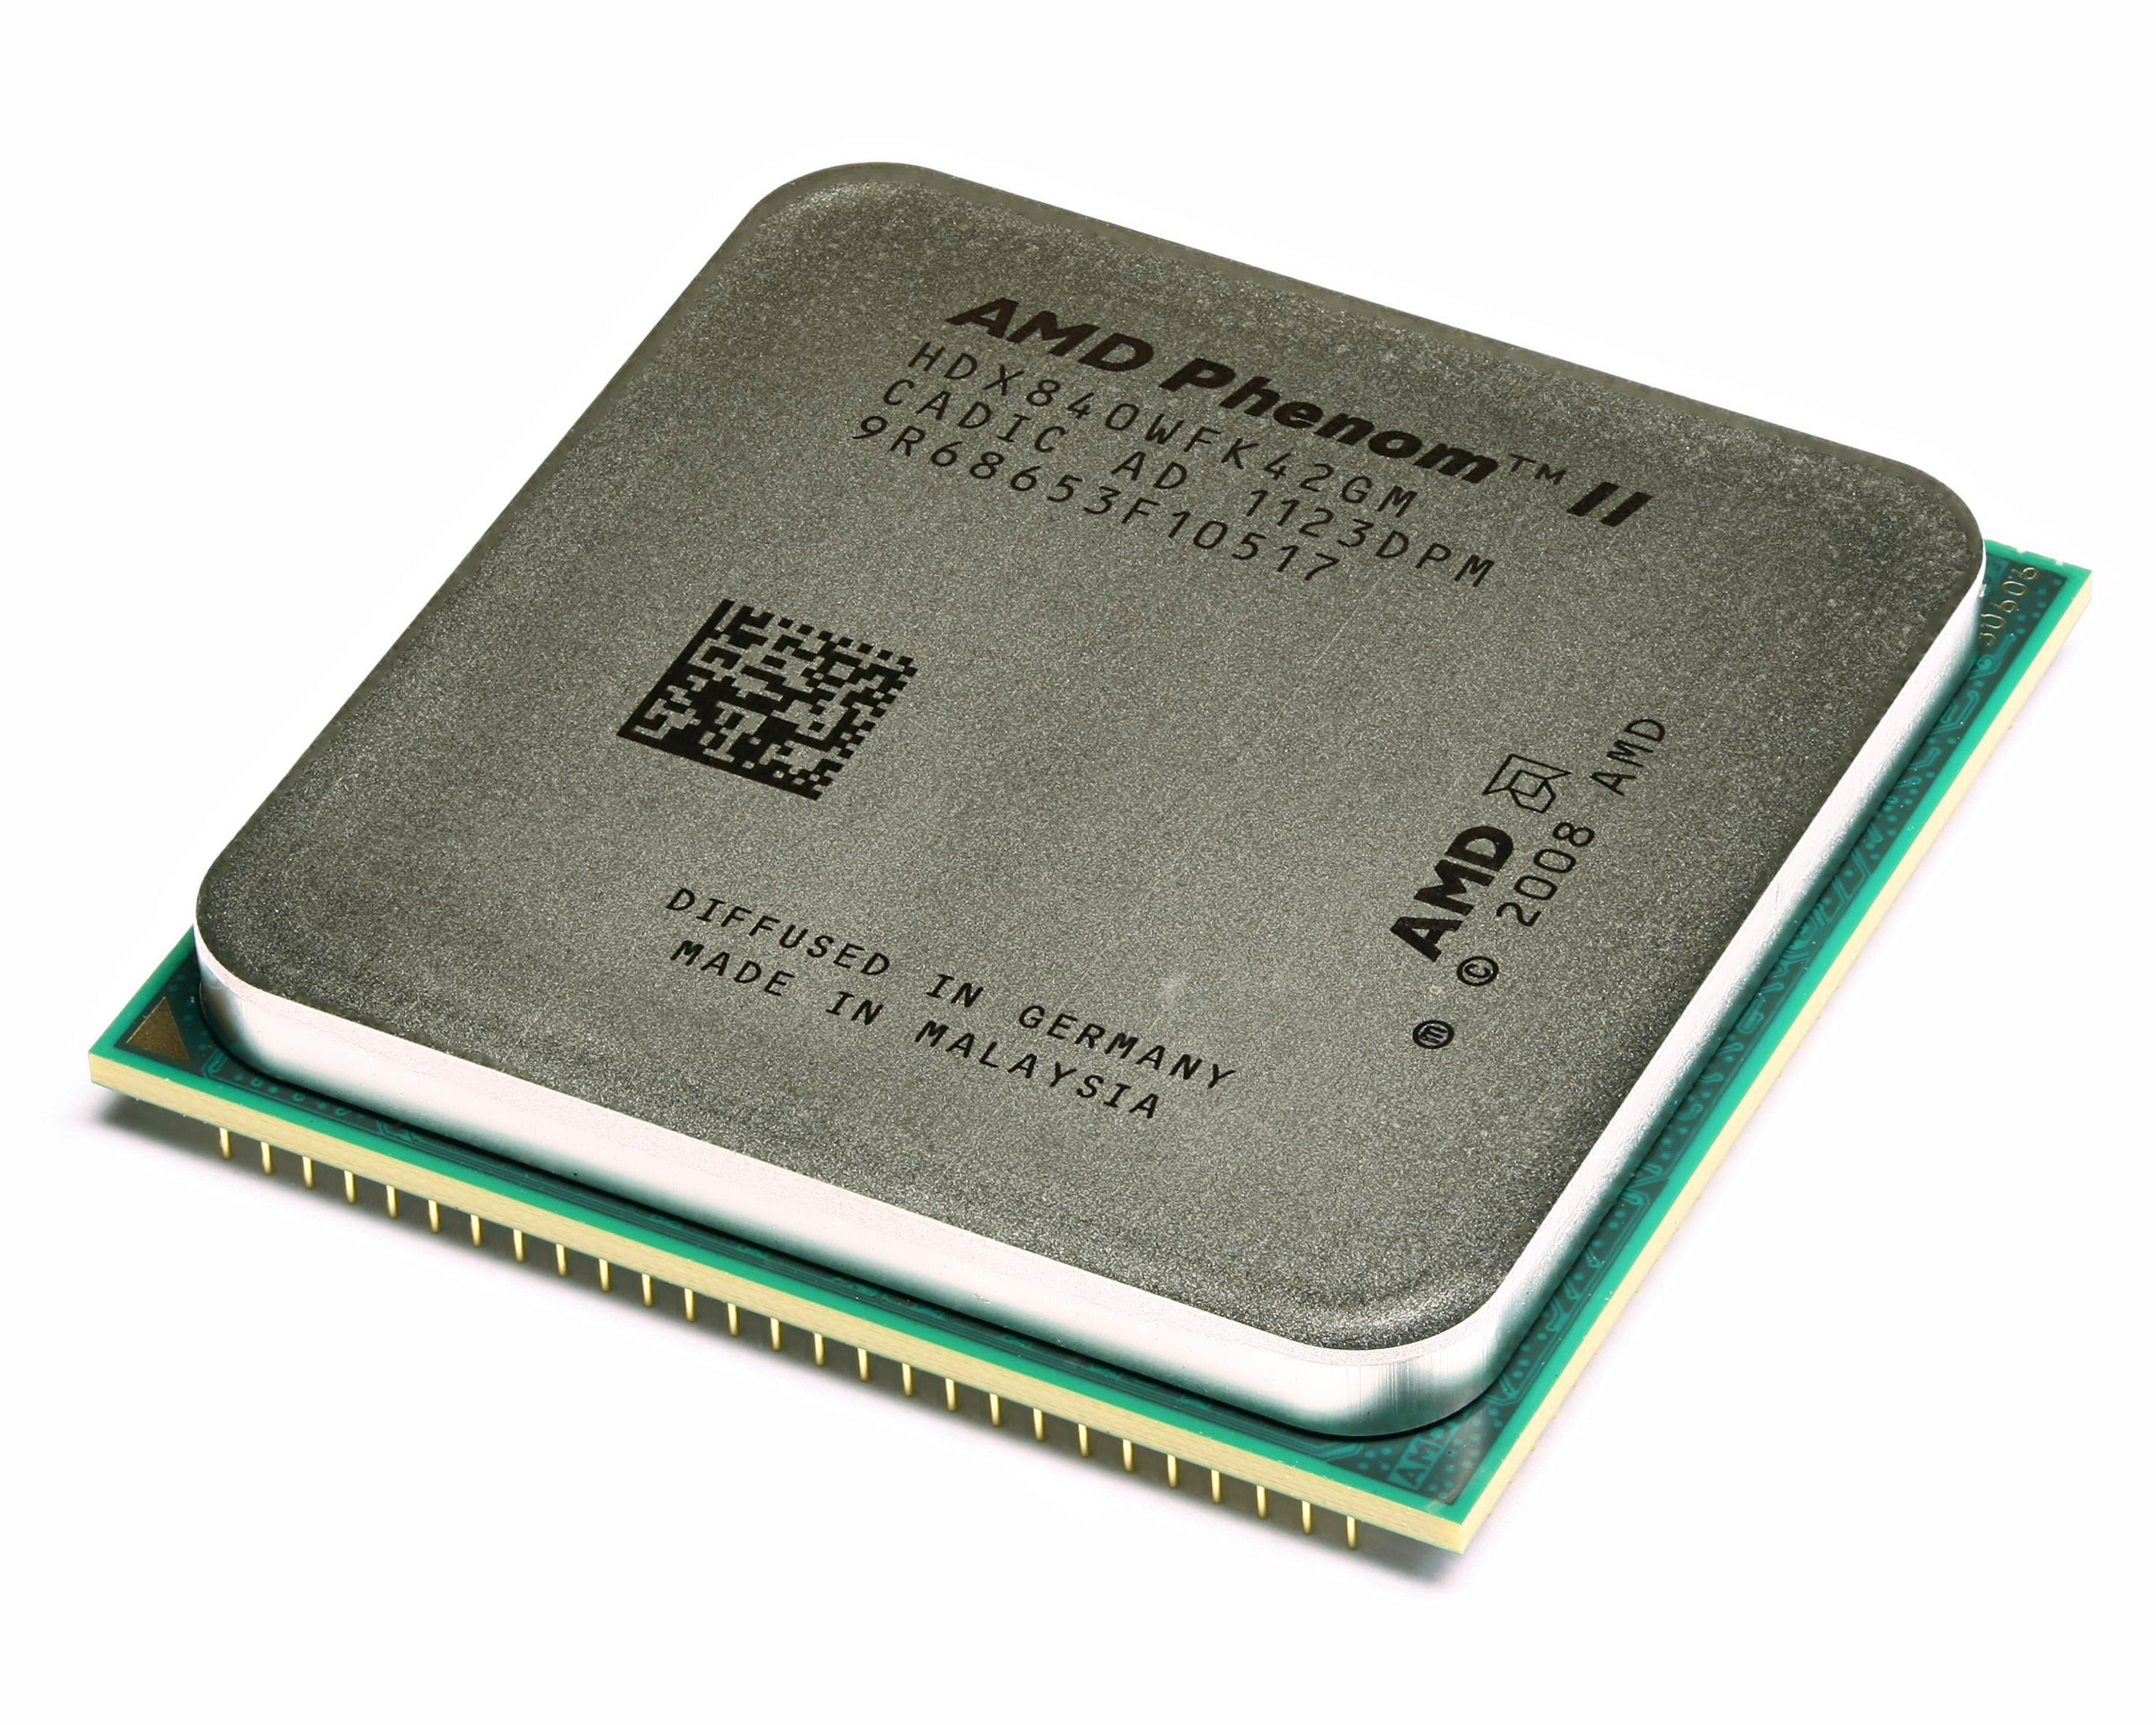
Year 8 Computing Learning Journey
End of year 8 …..
Year 9
End of year project
Vector vs Bitmaps
Shapes
Paths
Icons
Vector Graphics
Recap the basics
Selection
random numbers
String Manipulation
Data types
Boolean Operators
Further Python
What is a web site?
Planning a website
HTML
CSS
JavaScript
Web Design
Hardware inside a computer
History of the computer
Software
Peripherals
Threats
Hardware and software
Start
Notes:
2022 - 23

Slide 9
The Big Picture- Intent:
Year 9 aims to solidify knowledge gained in years 7 and 8. Now students have an understanding of how computers work and how they are physically connected, we explore the threats associated with networked computers. Students will then deeper their understanding of computational thinking and problem solving by completing a third programming unit in Python. This will build upon the foundation knowledge covered in previous years and embed more advanced techniques and good programming practice. Students will then undertake a spreadsheets unit of work. This cohort were unable to complete this important topic in previous years, however the application of skills in the real world is of high importance. Year 9 will conclude with e-safety, contextualised to the issues prevalent in the local area/school/age group. The aim is that students will be aware of dangers surrounding computer use with cross curricular links with ID/PSHCE.
All students will be able to access the main content of all lessons and all students will be taught to the top with scaffolding, adaptive teaching and stretch and challenge provided where necessary.
Implementation: There are four units of study in year 9. Each lesson will begin with a retrieval practice activity in the form of Revise, Recap, Review. This will normally involve students answering 3 questions from last lesson, followed by 2 questions from previous study and one more challenging question. Each activity will involve students being posed questions interleaved over multiple units delivered throughout the year. Students are encouraged work independently through the provision of scaffolding where required. Computing lessons often involve the application or practical/technical skills. These will be modelled to students using the I do, we do, you do approach. Students will be assessed at the end of each unit. Following assessment, students will complete a follow up activity based upon the individual area of weakness identified.
Cyber security: students will use their knowledge of networks and hardware to understand why network security is such a significant issue in society. Students will explore threats, attacks and how to defend against them
Advanced Python: Students will build upon their foundation knowledge of python and apply skills to ever more complex problems. Students will use sub-routines, lists, loops and create searching algorithms.
Modelling data: Learners are introduced to the wonderful world of spreadsheets and the concept of cell referencing. They will analyse data using functions and formulae and use sorting and filtering techniques to speed up retrieval.
* note, this unit will be studied by year 9 students starting at Idsall school in the academic year 2023/2024. Previous year groups will study data representations as year 7 unit 3 *
E-safety: Students will become aware of dangers associated with internet usage. This unit will explore issues around cyber-bullying, Coerced online child sexual abuse, Cyber-flashing, Gaming., Misinformation, Online Challenges and Pornography.
End of year project: Students will combine all of the skills taught in the units this year into an end of year project on a common theme
Key Summative Assessments:
End of unit assessments after each unit
Retrieval homework. ​
​
Live marking and low stakes quizzing ​
End of year project
Autumn Term:
Cyber security
Advanced Python
Spring term:
Modelling data/data representations*
Summer Term:
E-safety
End of year project
YEAR 9 CURRIULUM OVERVIEW – SUBJECT NAME
Impact: For many students, this will be the end of their computing studies. The impact of this KS3 curriculum is to prepare students to be digitally literate. This means Idsall students will know how to use common software packages, be able to think logically and apply this logic to real world scenarios, have an understanding of how and why the internet works and be able to use technology safely and respectfully.

Slide 10
Content​ | Disciplinary Knowledge (Skills)​ This is the actions taken within a ​ topic to gain ​ substantive knowledge​ | Substantive Knowledge​ This is the specific, factual content ​ for the topic, which is connected into a careful sequence of learning | Prior Learning (Y6/7/8/9)​ | Future learning (Y10)​
Cyber Security | Explore the differences between data and information Understand what social media may collect about it’s users and why Research and understand how humans can be the weak link in any computer system Know what a brute force attack is and why/how these can be successful Understand that malware is not just viruses. Know how different types of malware act Explore ways to increase network security | Data vs Information Data protection legislation Social engineering Hacking Brute force DOS/DDOS Malware Protection measures | Networks (Y7) Hardware and Software (Y8) | Apply knowledge of cyber security in the study of OCR J277 Computer Science
Advanced Python | To confidently use variables, inputs and printing, selecting the most appropriate data type To be able to use if, elif, else statements and nest these where required To be able to use condition controlled iteration in a program To be able to use count controlled iteration in a program To understand when to select between count/condition controlled loops To be able to use functions and procedures routinely in programs and understand the benefits To know why searching algorithms are important and to create a simple searching algorithm in python Make use of lists in python | Variables, inputs and printing Selection Lists Looping – WHILE Looping – FOR Sub programs Searching algorithms

Slide 11
Content​ | Disciplinary Knowledge (Skills)​ This is the actions taken within a ​ topic to gain ​ substantive knowledge​ | Substantive Knowledge​ This is the specific, factual content ​ for the topic, which is connected into a careful sequence of learning | Prior Learning (Y6/7/8/9)​ | Future learning (Y10)​
Spreadsheets | Accurately use cell referencing to apply formatting to specific ranges of cells in excel Create basic formulae to perform arithmetic in excel Make use of built in functions in excel to determine max, min, average, counta, countif and sum for cell ranges Collect primary data | Cell referencing Fill and formatting tools Formulae Primary and secondary data Functions in excel Filtering Sorting Conditional formatting Charts and graphs | collecting, analysing, evaluating and presenting data and information | Spreadsheets feature on the BTEC DIT 2022 specification
E-safety | Students understand what is meant by cyber-bullying and how to report concerns Students gain an understanding of and ability to identify coercive behaviour Exploration of legislation and motivation around cyber flashing Students will explore the benefits of gaming as well as the dangers/negative impacts and behaviours gaming can lead to Students will explore what is misinformation and disinformation and why this has become such an issue Students will be able to identify the dangers surrounding online challenges Students will understand the negative impact online pornography can have and how this can lead to misconceptions, support toxic masculinity and affect behaviours | Cyber-bullying Coerced online child sexual abuse Cyber-flashing Gaming Misinformation Online Challenges Pornography. | SRE program | ID/SRE program

Slide 12
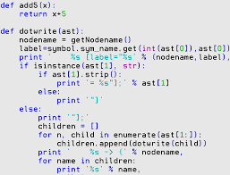
Year 9 Computing Learning Journey
End of year 9 …..
KS4
End of year project
Cyber-bullying
Coerced online abuse
Cyber-flashing
Gaming
Misinformation and disinformation
Online Challenges
Pornography
Loops
Selection
Lists
Functions and procedures
Searching algorithms
E-Safety
Advanced Python
Binary number system
Binary conversions
Representing characters
Representing images
Representing sounds
Risks
Social Engineering
Hacking
Legislation
Malware
Prevention methods
Data representations
Cyber Security
Start
Notes:
2022 - 23

